Slide 1

NFL Wagering – Predictive Analytics
Doug Marcum

Slide 2
Overview and Goal
Sports betting is not a new phenomenon in the United States, but due to recent legislation, it is experiencing a surge. With 25 states now allowing their residents to wager on sporting events in varying capacities, consumers are searching for tools to assist in making predictions or rather, to gain an edge in their selection process. Resources are available, but often they are not validated, are high priced, or do not provide any true guidance. With the work being conducted under this project, the hope is that through data science, the average gambler can be informed in making their selections.
By analyzing ten, 10, NFL seasons consisting of 256 unique games each season, classification models can be implemented and tested to see if accuracy rates exceeding 52.4% can consistently be processed. If this is successful, future research into other professional arenas (basketball, baseball, soccer, hockey) can be reviewed. Sports betting, once considered to be taboo and sinful, has grown into a true corporate enterprise. Given this overall popularity, the field is just being explored, and the need for data scientists to engage and discover insights will continue to increase.

Slide 3
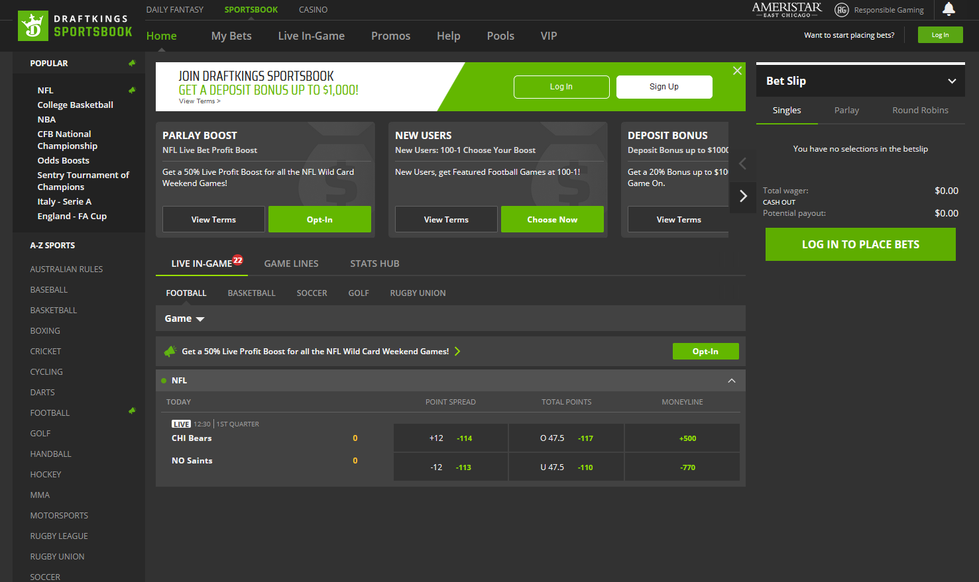
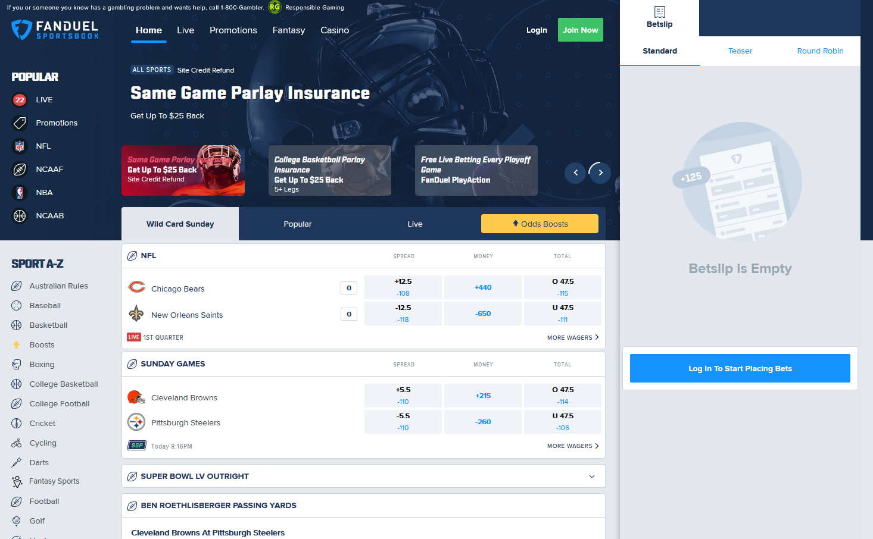
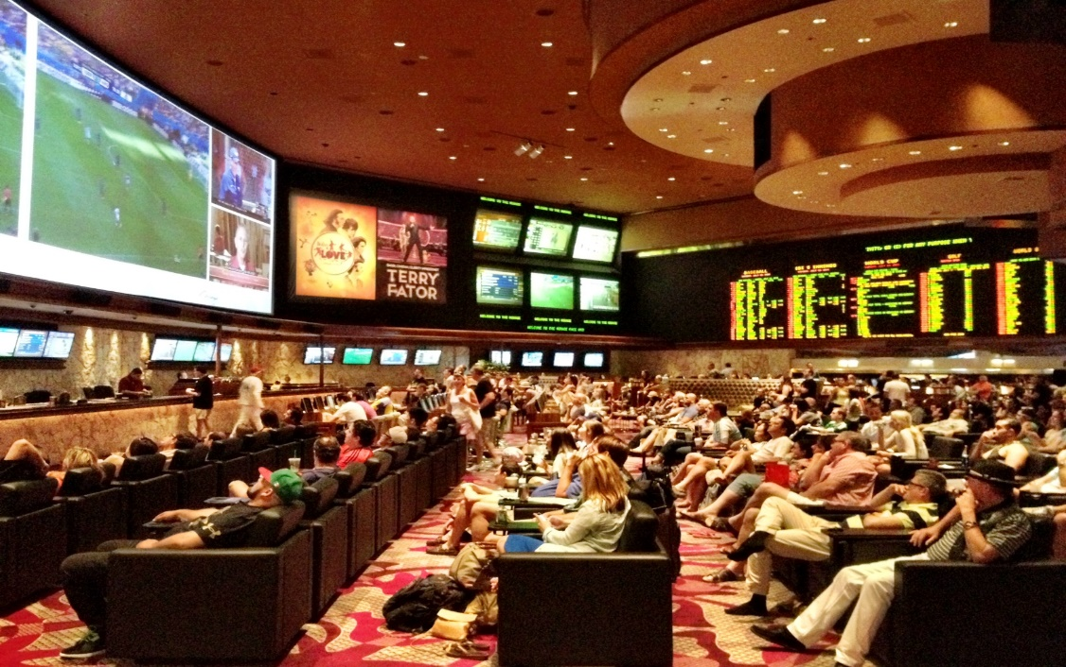
Background

Slide 4
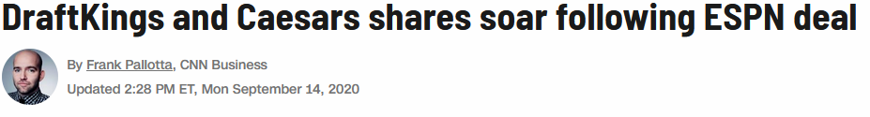
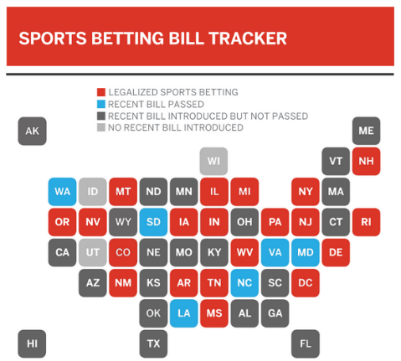
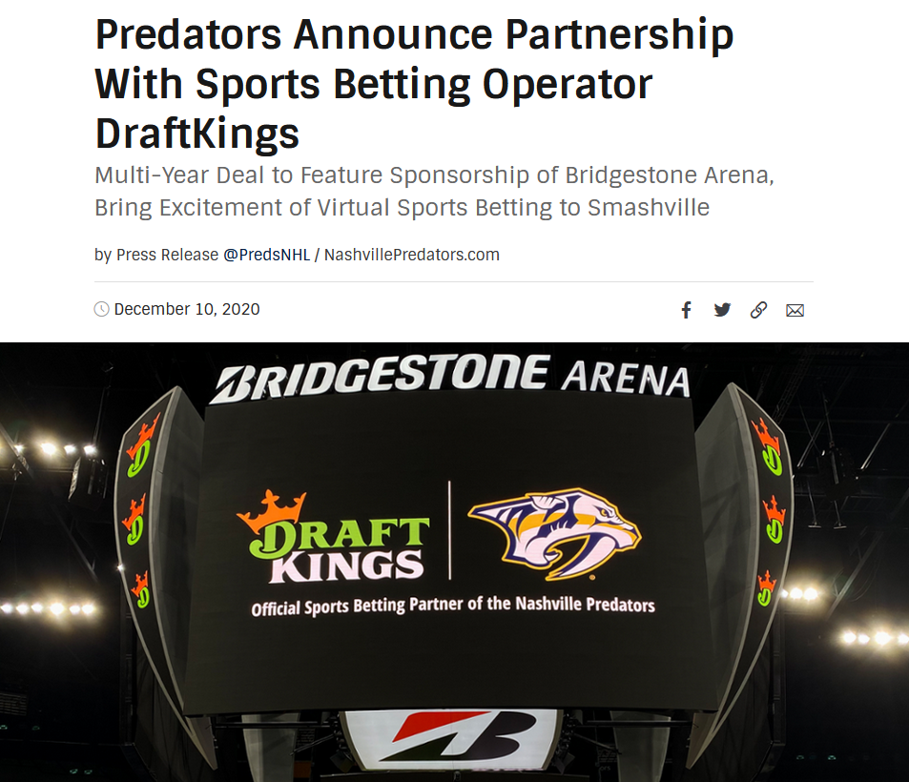
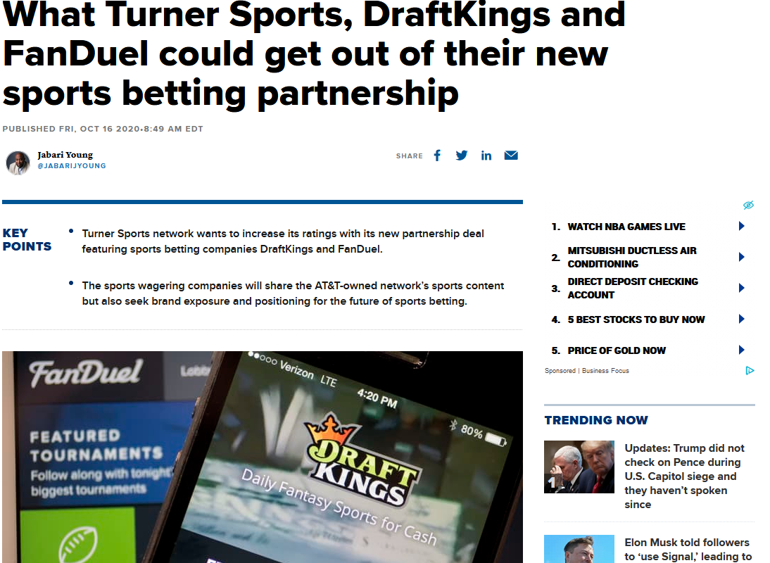
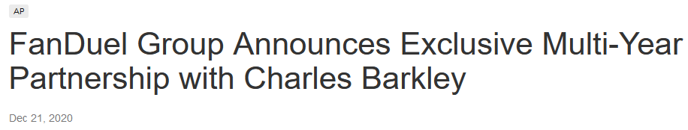
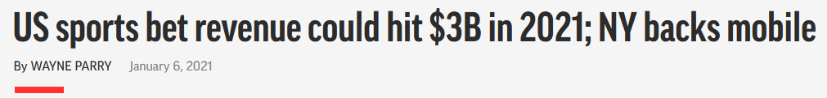
Background (continued)

Slide 5
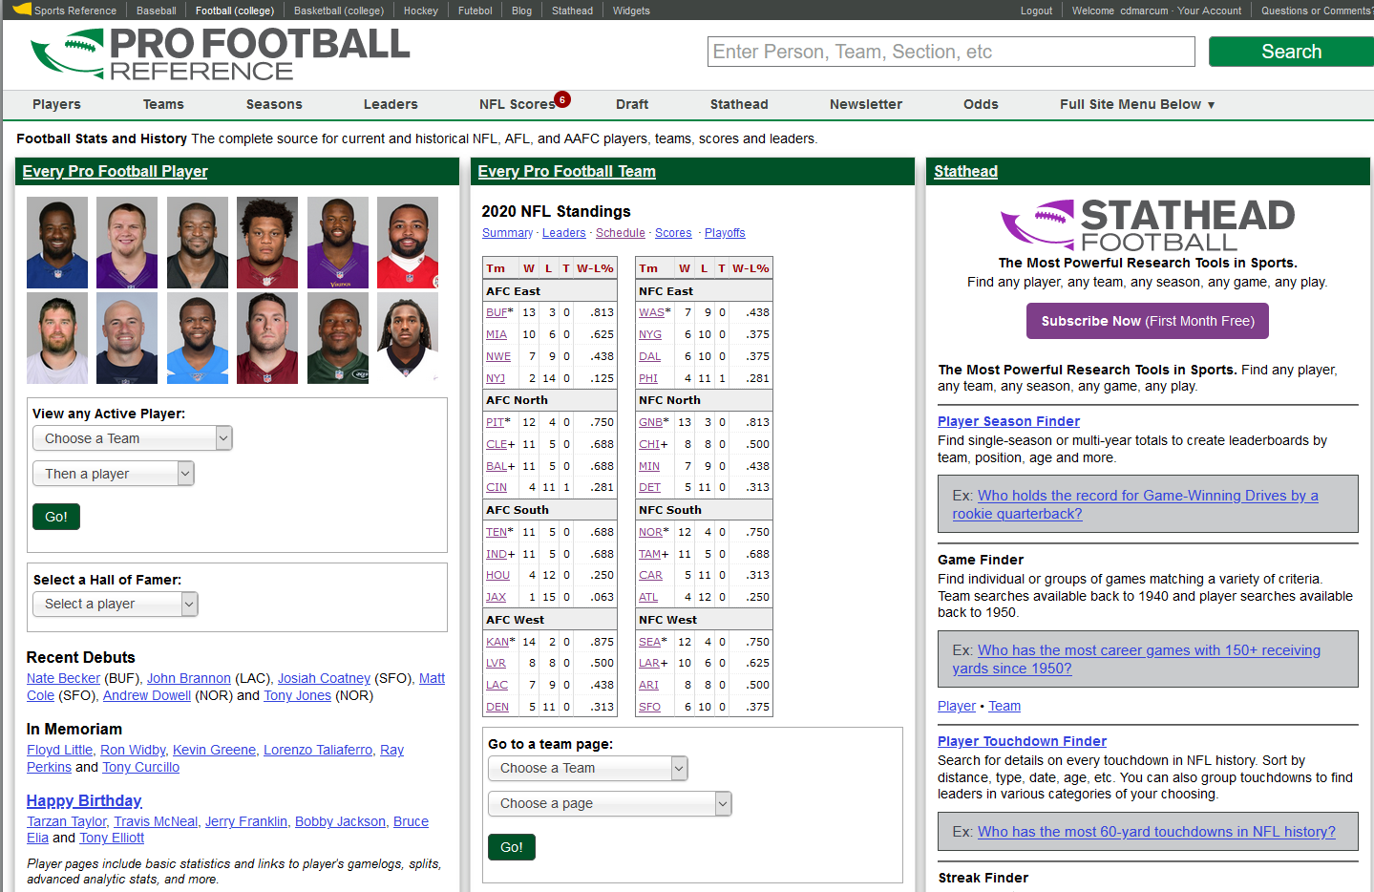
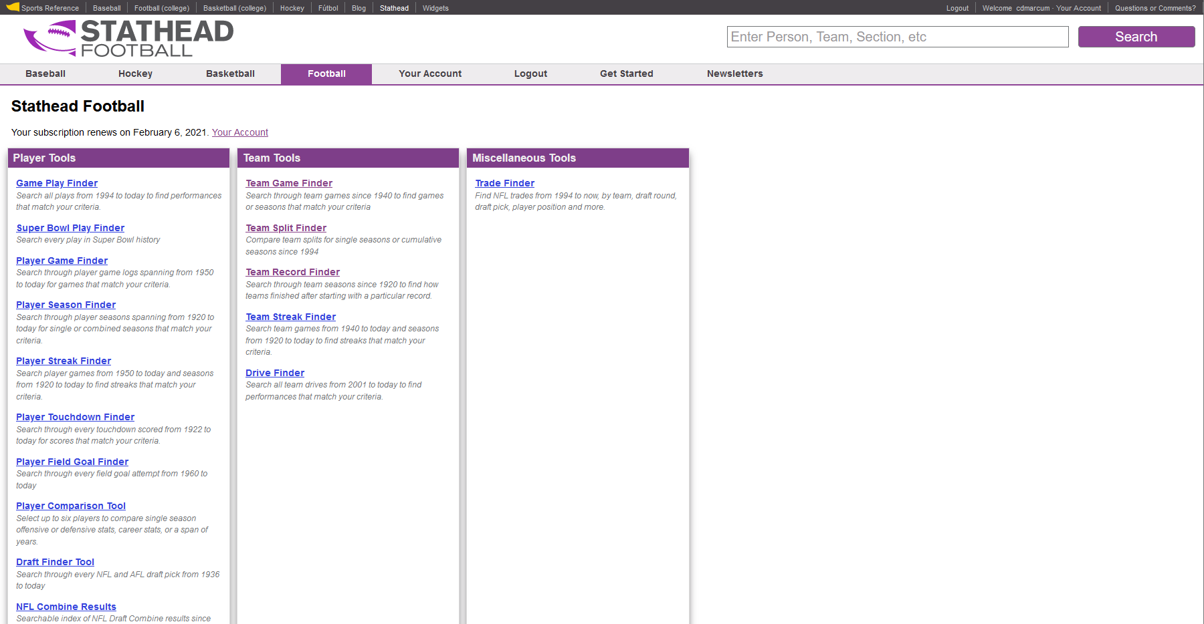
Data

Slide 6
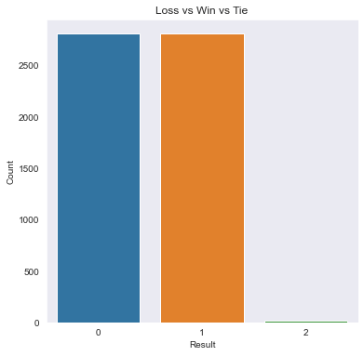
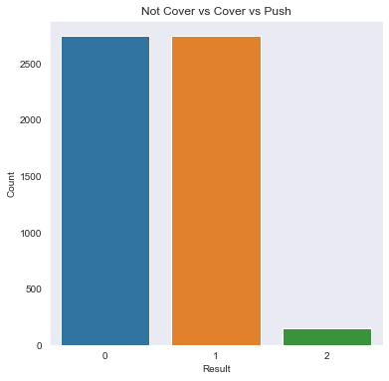
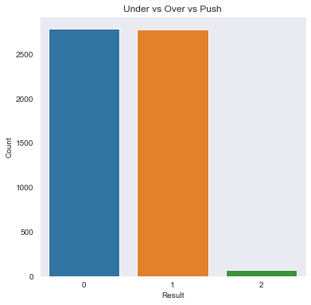
Data Understanding and Preparation

Slide 7
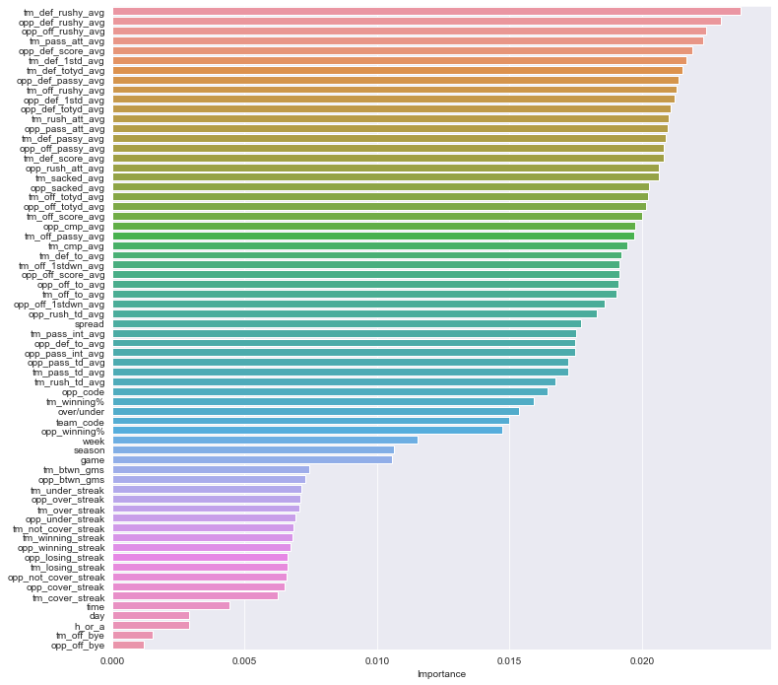
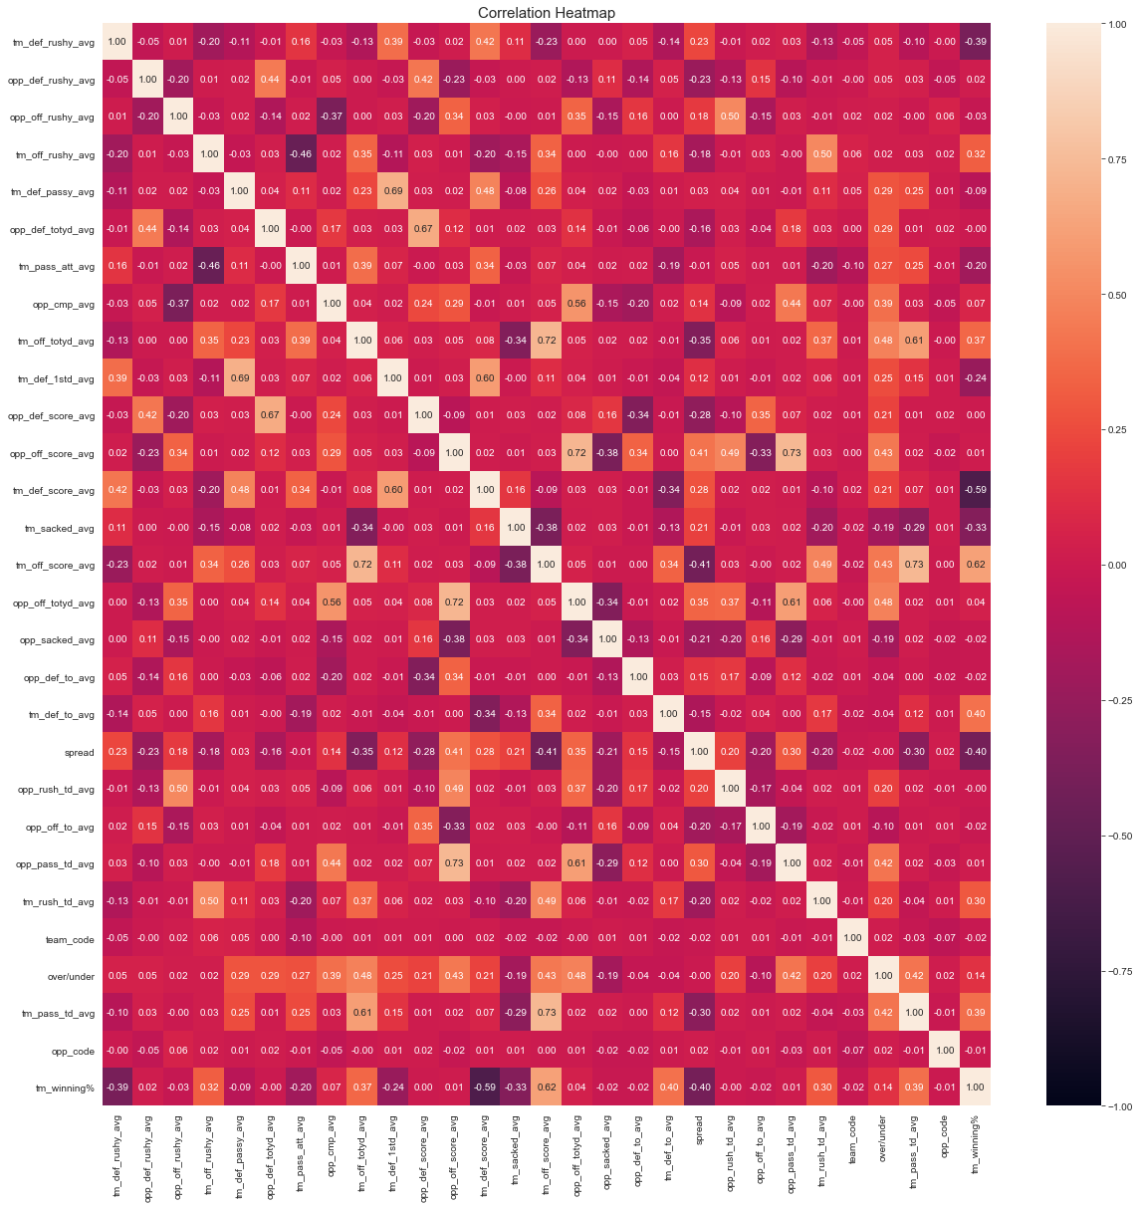
Data – Feature Selection
Spread – Feature Importance Spread - Correlation Heatmap

Slide 8
Model Preparation and Selection
Data split in 80% training and 20% testing sets
Samples in training sets range between the three groups: 3739 - 3832
Samples in testing sets range between the three groups: 935 - 958
Models selected for testing and evaluation:
Random Forest Classifier
Logistic Regression
K Nearest Neighbor
Gaussian Naïve Bayes
Artificial Neural Network

Slide 9
Results
Results varied from category to category. Looking first at the results when predicting a winning team, the models performed well and consistent across the board. Accuracy ranged from 64 – 66%, with Precision, Recall, and F1-Score all scoring relatively the same. This was better than expected, as the predictions were solely based off the previous seasons data and no new data being added during the course of the 2020 season.
The models for predicting a team’s ability to cover or not cover a point spread and those to determine if a total score will be over or under have been inconsistent. Each model’s accuracy score was based off performing 10 cross validations. The results of the Over / Under predictions are as follows:
As can be seen, the results are only slightly better than 50%, but two models, GaussianNB and Artificial Neural Network (ANN), were able to slight come out ahead of the 52.4% threshold. The results of each model’s prediction ability relating to the spread are listed below:
Random Forest | Logistic Regression | K Nearest Neighbor | Gaussian NB | Artificial Neural Network
51.68% | 52.31% | 51.38% | 52.73% | 52.64%
Random Forest | Logistic Regression | K Nearest Neighbor | Gaussian NB | Artificial Neural Network
49.86% | 49.53% | 51.13% | 50.28% | 53.16

Slide 10
Results
Confidence Threshold Adjusted Consensus (CTAC)
1. The confidence threshold was established after week 2 predictions were finalized. These baseline confidence levels can be seen here: https://github.com/MarcumDoug/NFL_Wagering-Predictive_Analysis/tree/main/Results.
2. After the new data frames were created, each game was evaluated to determine a consensus prediction from the models. A majority selection (i.e., 2-1) was necessary for a game to be allowed into a selection. If there was no clear consensus (i.e., 2-2), the game was labeled a push and no selection metric was made.

Slide 11
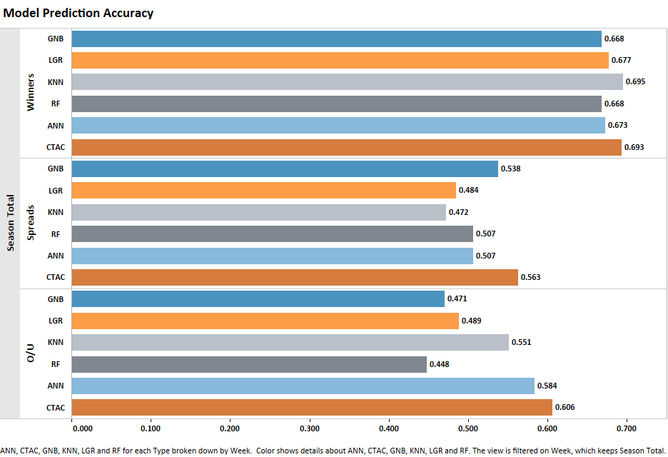

Slide 12
Conclusion

Slide 13
All data files and code can be found at:
https://github.com/MarcumDoug/NFL_Wagering-Predictive_Analysis
Any questions or follow ups can be directed to this site as well.
Thank you for your time and I hope this was informative.

